Slide 1



VECTRA
Reimagining film production with AI
Ann Evelin Vincent
Athira S
Irene Sara Philipose

Slide 2

Behind the Scenes: The Challenges
Scattered tools, no unified platform
Poor collaboration across teams
Budgets spiral out of control
Manual tracking slows production
No AI-driven insights or predictions
Production chaos needs a smarter system.

Slide 3
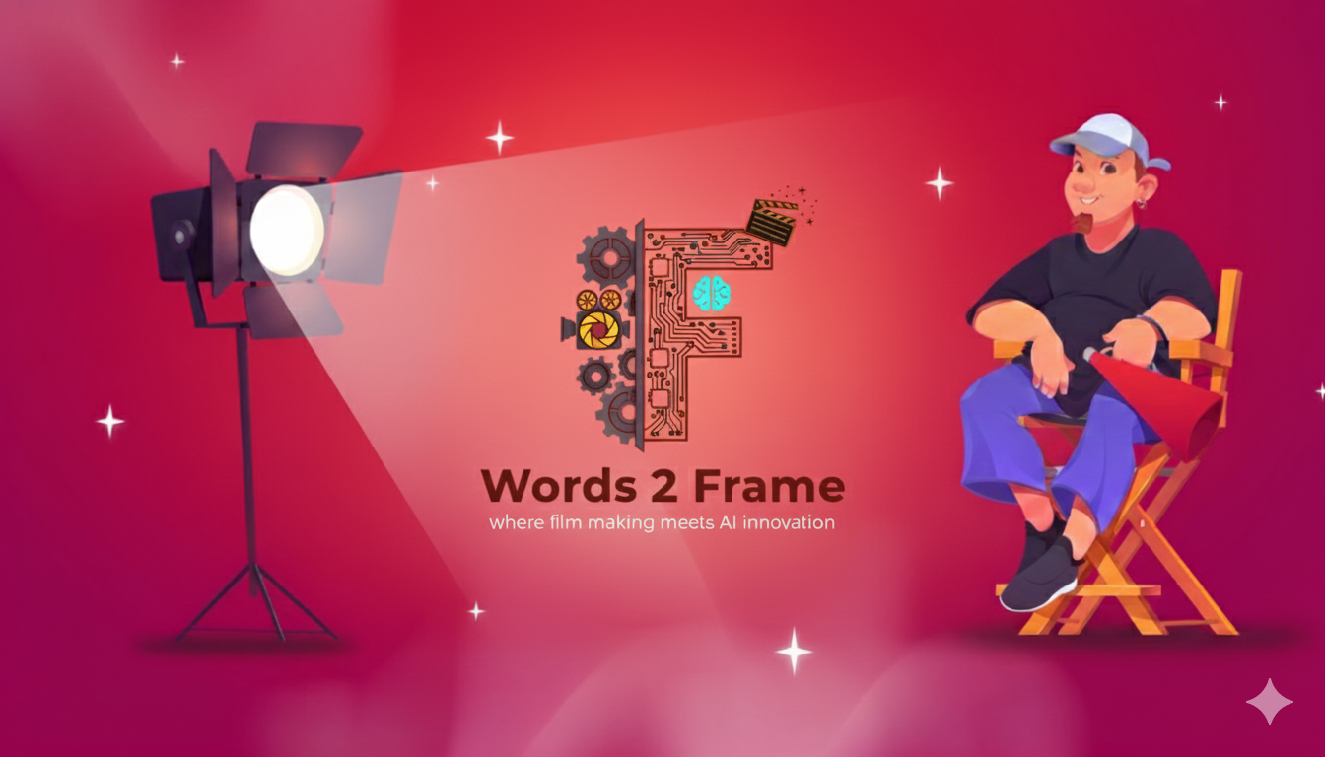

Slide 4







How Words 2 Frame Works
Script
Dashboard
Creative input that starts it all
Visualises data and insights instantly
AI Processing
Film Workflow Management
Analyse and extract key details
Turns ideas into organised production

Slide 5




From Vision to Value
30% faster production planning through AI automation.
Up to 25% budget savings via predictive cost control.
Improved collaboration across all departments in real time.
Streamlined workflow from pre- to post-production.
Data-driven insights for smarter decision-making and scheduling.
Smarter workflows. Bigger savings. Better films

Slide 6

Rolling into the Future
Weather-Based Scheduling
Mobile & Email Reminders
AI Chat Assistant
Multi-Script Management
Auto-adjust shoots by forecast
Instant alerts and updates
Your 24/7 production guide
Handle many projects easily in the same timeline

Slide 7

THANKS!
The Future of Filmmaking Begins Here.
Innovation. Intelligence. Imagination — all in one frame.

